Slide 1
Session – 16
KANBAN

Slide 2
Topics to be discussed
Where did Kanban originate?
What is the Kanban Method?
Kanban Foundational Principles
6 Core Practices of the Kanban
Positive side of Kanban
Main components of Kanban Board
WIP Limits in Kanban
Prioritizing the Kanban Backlog

Slide 3
6 Core Practices of the Kanban Method
Visualize the flow of work
Limit WIP (Work in Progress)
Manage Flow
Make Process Policies Explicit
Implement Feedback Loops
Improve Collaboratively, Evolve Experimentally (using the scientific method)

Slide 4
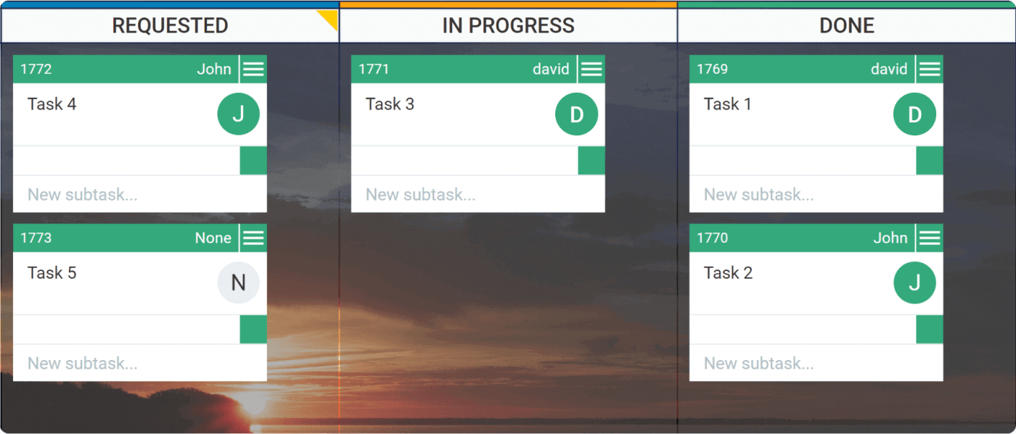
Visualize the flow of work:

Slide 5
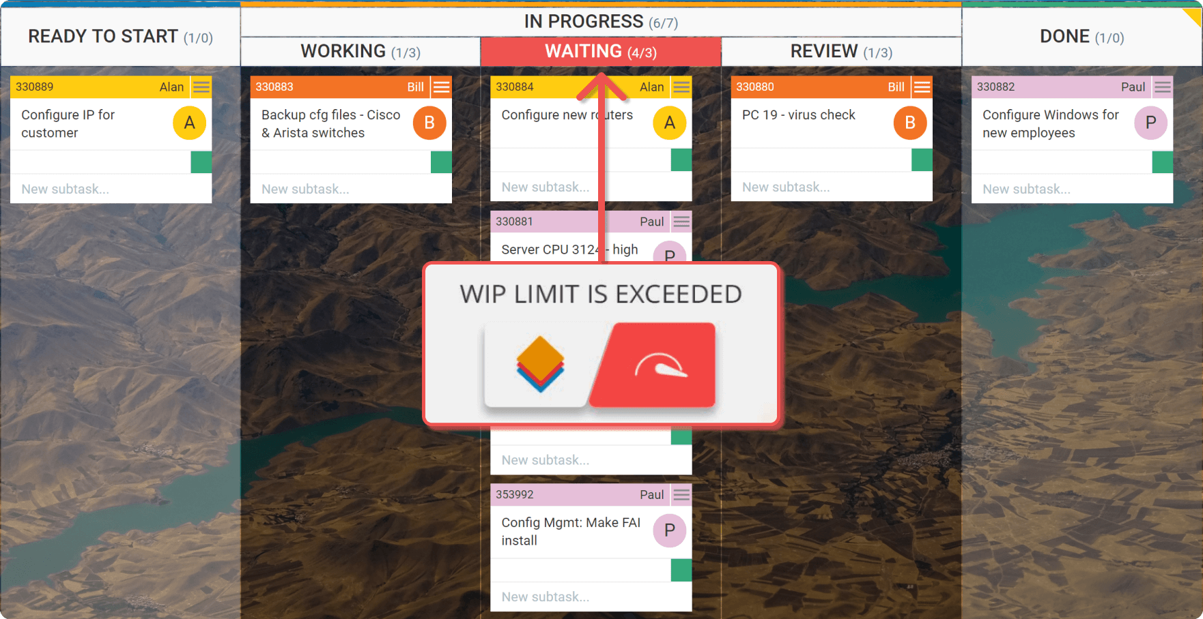
Limit work in progress
Limit WIP (Work in Progress)
Notes:
Setting maximum items per stage ensures that a card is only “pulled” into the next step when there is available capacity.

Slide 6
The Positive Side of Kanban
Everyone is on the same page
Kanban reveals bottlenecks in your workflow
Kanban brings flexibility
Your team gets more responsive
You focus on finishing work to boost collaboration and productivity

Slide 7
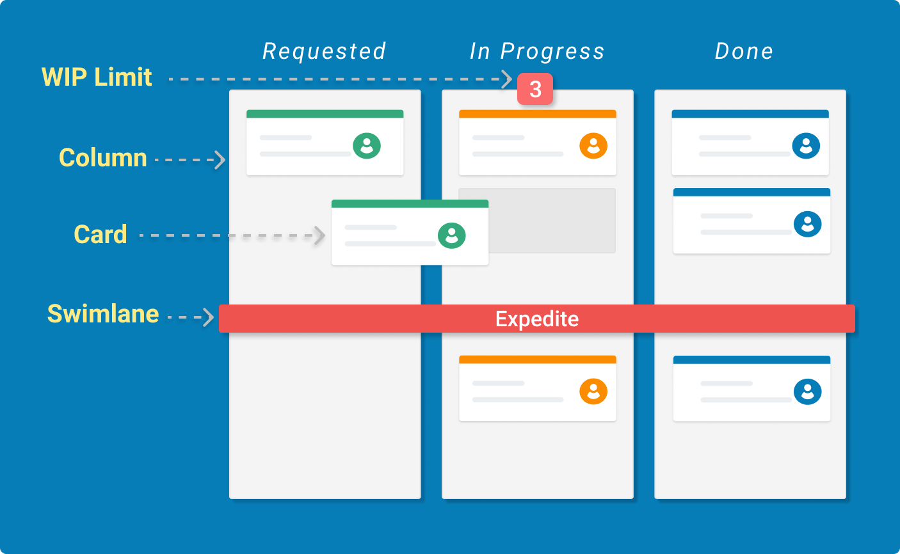
Main Components of the Kanban board

Slide 8
Kanban Cards – This is the visual representation of tasks. Each card contains information about the task and its status such as deadline, assignee, description, etc.
Kanban Columns – Each column on the board represents a different stage of your workflow. The cards go through the workflow until their full completion.
Work-in-Progress Limits – They restrict the maximum amount of tasks in the different stages of the workflow. Limiting WIP allows you to finish work items faster, by helping your team to focus only on current tasks.
Kanban Swimlanes – These are horizontal lanes you can use to separate different types of activities, teams, classes of service,

Slide 9
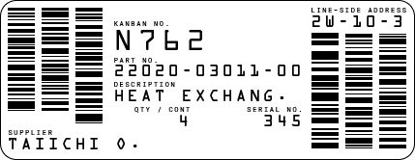
What Is a Kanban Card?
A Kanban card contains valuable information about the task and its status such as a summary of the assignment, responsible person, deadline, etc.
An example of a physical Kanban card.

Slide 10
Kanban WIP Limits

Slide 11
The acronym WIP stands for Work In Progress. WIP is the number of task items that a team is currently working on. It frames the capacity of your team’s workflow at any moment. Limiting work in progress is one of the core properties of Kanban. It allows you to manage your process in a way that creates smooth workflow and prevents overloads.

Slide 12
Prioritizing the Kanban Backlog
The backlog is the space where you place work items or ideas that will be done in the near or distant future. However, there is no guarantee that all tasks in the Kanban Backlog will be delivered. The items in this column are more like an option the team has for the future work rather than a commitment point.

Slide 13
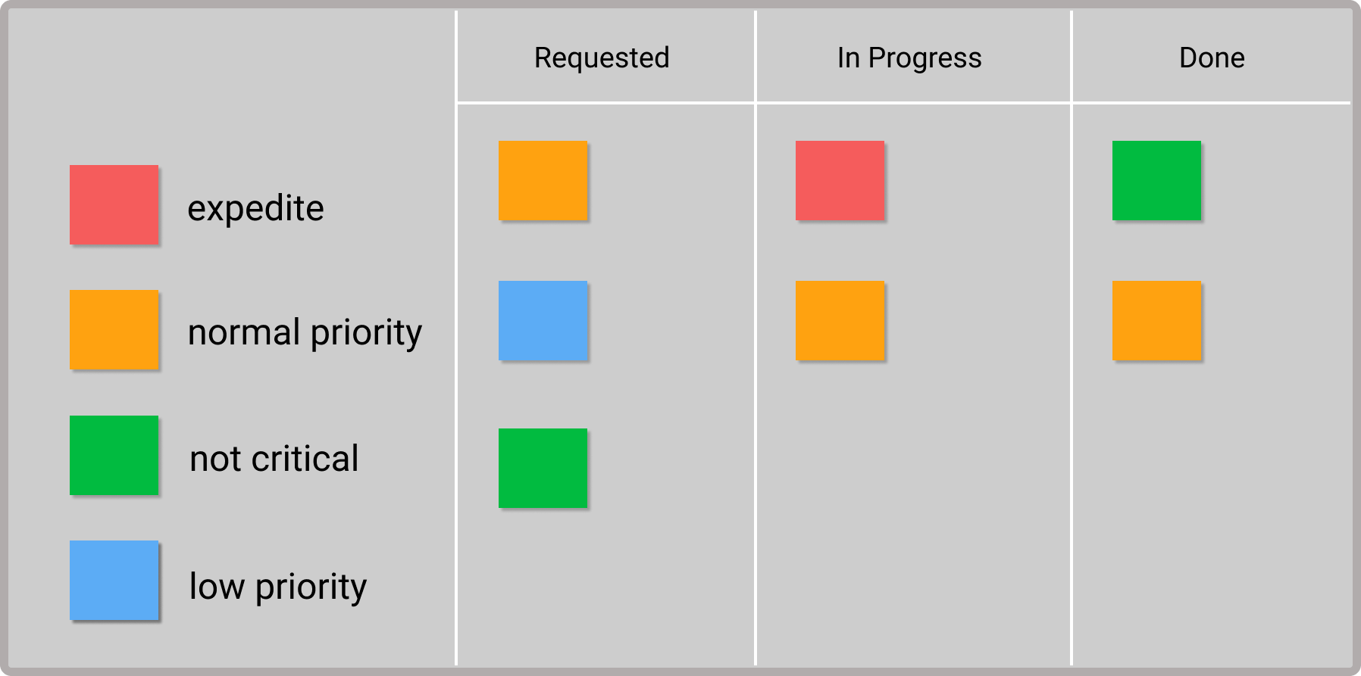
Prioritizing Tasks With Color Indicators

Slide 14
Questions
Define Kanban.
Where did Kanban originate?
What is the Kanban Method?
Explain Kanban Foundational Principles
List out the 6 Core Practices of the Kanban
How does Kanban work? – The Concept
What are WIP Limits in Kanban.

